Slide 1
Environment
This is our environment

Slide 2
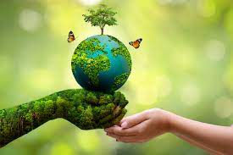
Environment
Environment means all the natural surroundings such as land, air, water, plants, animals, solid material, wastes, sunlight, forests and other things. Healthy environment maintains the nature's balance as well as helps in growing, nourishing and developing all the living things on the earth.

Slide 3
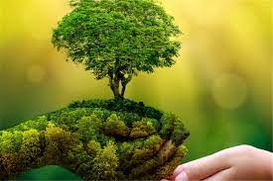
Environment
Trees are necessary for our survival. They provide us with the oxygen we need to breathe, the food we need to eat, and the materials we need to build our homes and furniture. They also help to regulate the climate, protect the soil, and provide homes for wildlife.

Slide 4
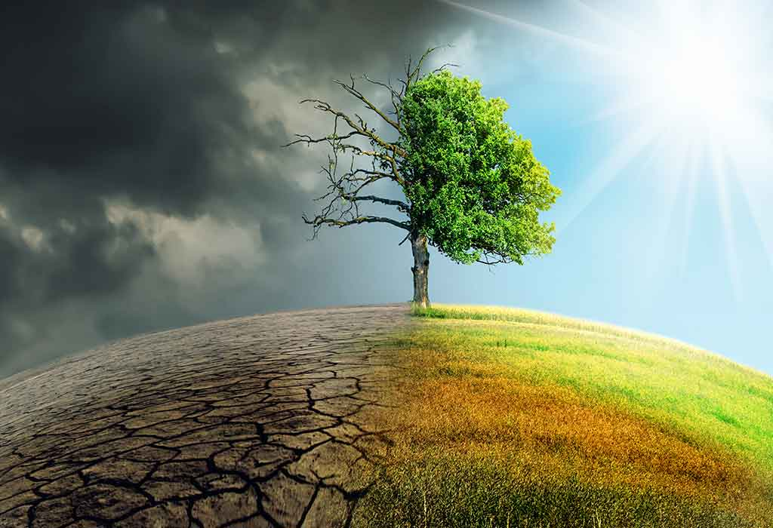
Environment pollution
Environmental pollution is unwarranted disposal of mass or energy into earth's natural resource pool such as water, land, or air that results in long- or short-term detriment to the atmosphere and its ecological health to negatively impact the living beings and their life both quantitatively and qualitatively (Hussain, ...

Slide 5
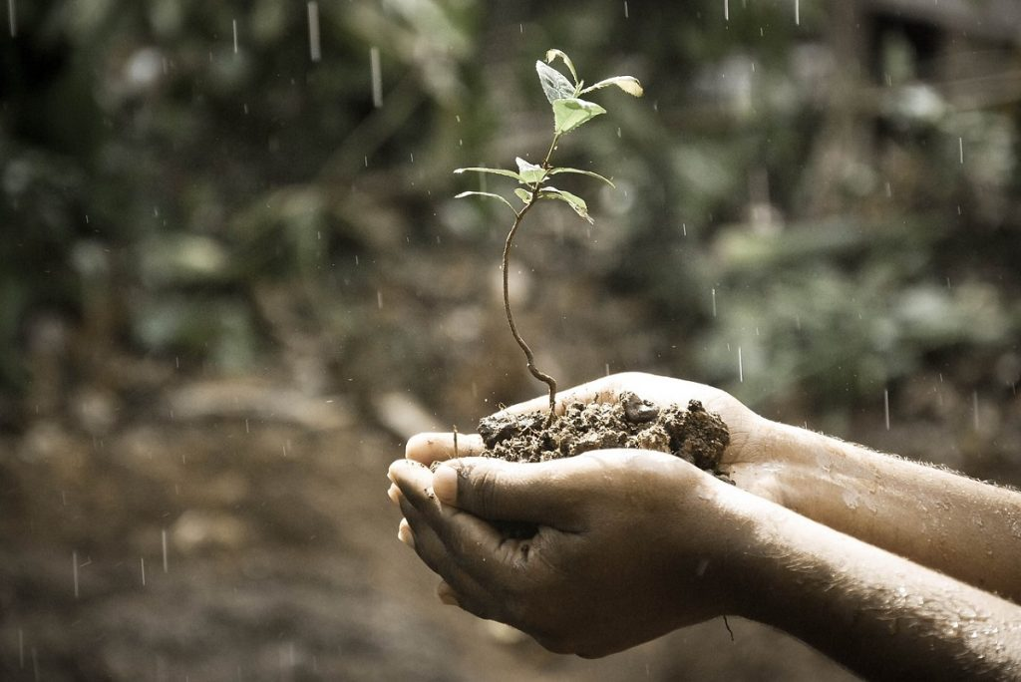
Environment
7. WRONG PLACE TO PLANT
Windy areas, which can burn or damage plants.
Areas in full sun, which can burn the plant or dry out the ground around the plant.
Very dark areas, where only specific types of plants will grow.
Reflective heat will burn your plant quickly, such as plants positioned against hot fences.

